Slide 1

HealthCare Analytics (Patient length of stay (LOS))
Siddam Sai PhaniNdra

Slide 2

AGENDA
Introduction
Data Overview
Data Pre-processing
Exploratory Data Analysis (EDA)
Machine Learning Models
Model Evaluation
Conclusion

Slide 3
Introduction
Problem Statement:
Recent Covid-19 Pandemic has raised alarms over one of the most overlooked area to focus: Healthcare Management.
While healthcare management has various use cases for using data science, patient length of stay is one critical parameter to observe and predict if one wants to improve the efficiency of the healthcare management in a hospital.
Objective
This parameter helps hospitals to identify patients of high LOS risk (patients who will stay longer) at the time of admission. Once identified, patients with high LOS risk can have their treatment plan optimized to minimize LOS and lower the chance of staff/visitor infection. Also, prior knowledge of LOS can aid in logistics such as room and bed allocation planning
Scope
The project will use historical data from a hospital database, and apply machine learning techniques to build and evaluate the predictive model. The project will also explore the implications of the model for hospital resource allocation and patient satisfaction days.

Slide 4
Data Overview
case_id :- Case_ID registered in Hospital
Hospital_code ;- Unique code for the Hospital
Hospital_type_code:- Unique code for the type of Hospital
City_Code_Hospital :- City Code of the Hospital
Hospital_region_code;- Region Code of the Hospital
Available Extra Rooms in Hospital: - Number of Extra rooms available in the Hospital
Department :- Department overlooking the case
Ward_Type :- Code for the Ward type
Ward_Facility_Code:- Code for the Ward Facility
Bed Grade:- Condition of Bed in the Ward
Patientid :- Unique Patient Id
City_Code_Patient:- City Code for the patient
Type of Admission : Admission Type registered by the Hospital
Severity of Illness : Severity of the illness recorded at the time of admission
Visitors with Patient: Number of Visitors with the patient
Age: Age of the patient
Admission_Deposit: Deposit at the Admission Time
Stay (Traget Variable): Stay Days by the patient

Slide 5
Data Pre-processing
Handling missing values.
Handling the missing values using mode for Bed Grade and City_Code_Patient
Dropping unnecessary columns (case_id, patientid).
case_id and patientid are typically unique identifiers assigned to each case or patient in the dataset. These identifiers do not provide any meaningful information for predicting the target variable (patient length of stay in this case). Including unique identifiers as features in the model could potentially introduce noise and overfitting, as the model may mistakenly learn patterns specific to individual identifiers that do not generalize to new data.
Label encoding for categorical variables using the pd.get_dummies.

Slide 6
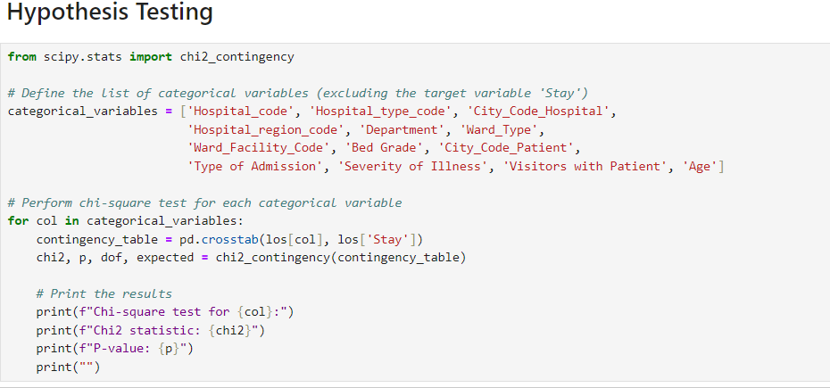
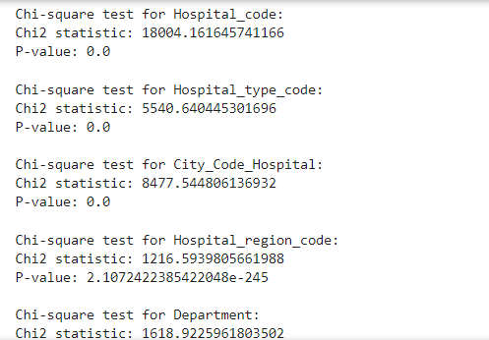
Exploratory Data Analysis (EDA)
Chi-square tests for categorical variable significance to find the relation between them. As the result P-value was less then 0.05. Hence Alternative hypothesis true, there is a relationship between the stay and variables' present in the dataset.
Analysis of target variable distribution (Stay) for Data Visualization.

Slide 7
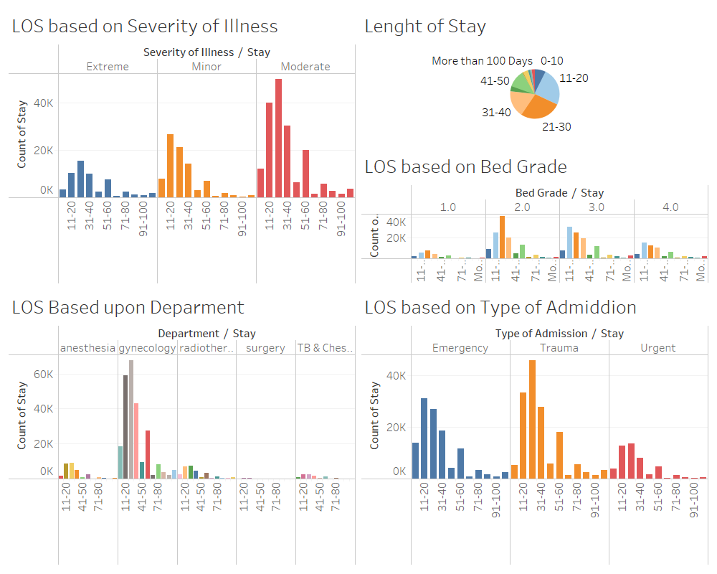
Data Visualization

Slide 8
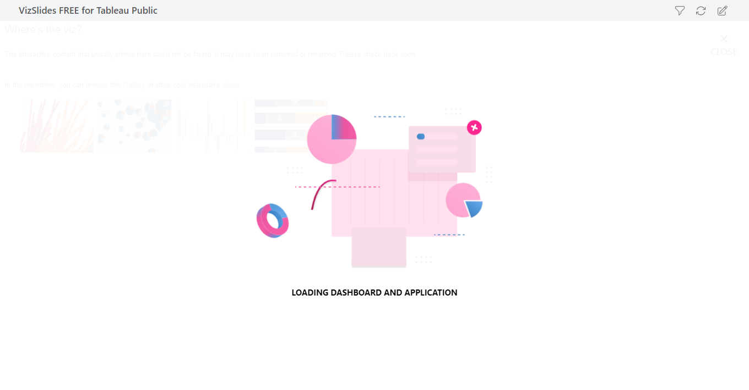

Slide 9
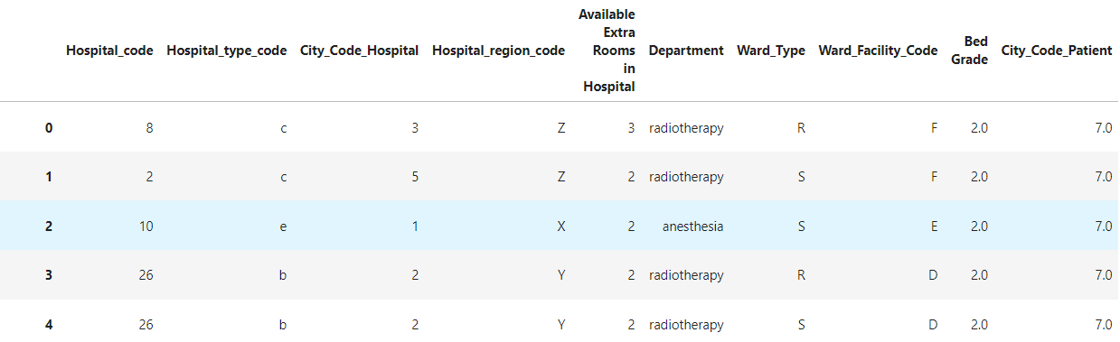
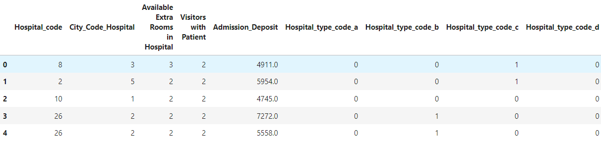
Label Encoding
The `pd.get_dummies` function in **pandas** is used to convert categorical variables into dummy or indicator variables. It creates new binary columns for each category within the categorical variable, indicating whether a specific category is present in the original data or not.

Slide 10
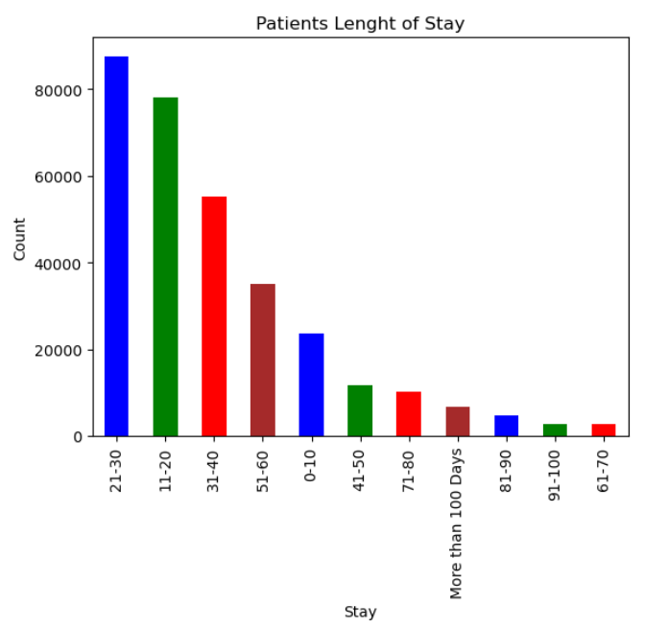
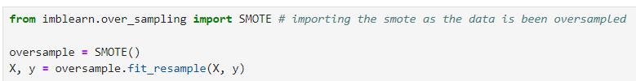
Dealing with the Imbalanced Data
As, we can here the data of the stay is an imbalanced. Hence, here we are using smote to balance the data of the stay.

Slide 11
Machine Learning Models
The train-test split is a fundamental technique in machine learning for assessing model performance, preventing overfitting, tuning hyperparameters, ensuring generalization, and comparing different models. It's a critical step in the model development process that helps improve the reliability and effectiveness of machine learning models.
Dataset has been split into Train and Test, where train has 70% of the dataset and respectively 30% towards test data.

Slide 12
Machine Learning Models
Models used for predicting the LOS are
Logistic Regression
Random Forest
GBM
XGBoost
Catboost
Naive Bayes
ANN
CNN.

Slide 13
Machine Learning Models
Hyperparameters tuning these hyperparameters appropriately can significantly impact the performance of the models in terms of accuracy, precision, recall, and other evaluation metrics.
Logistic Regression:- max_iter.
Random Forest:- n_estimators, max_depth & random_state.
Gradient Boosting Machines (GBM) & XGBoost :- n_estimators, learning_rate, max_depth & random_state.
Catboost :- iterations, learning_rate, loss_function & verbose

Slide 14
Machine Learning Models Evaluation
Comparison of models based on ML model scores and F1 scores.
Logistic Regression: Achieved an ML model score of 0.3048 and an F1 score of 0.31.
Random Forest: Achieved an ML model score of 0.3947 and an F1 score of 0.39.
Gradient Boosting Machines: Achieved an ML model score of 0.4020 and an F1 score of 0.40.
XGBoost: Achieved an ML model score of 0.3859 and an F1 score of 0.39.
Catboost: Achieved the highest ML model score of 0.4767 and an F1 score of 0.46.
Gaussian Naive Bayes: Achieved an ML model score of 0.2087 and an F1 score of 0.46.
Fully Connected Layer (ANN): Achieved an ML model score of 0.0901 and an F1 score of 0.09.
Convolutional Neural Network: Also achieved an ML model score of 0.0901 and an F1 score of 0.09.

Slide 15
Machine Learning Models Evaluation
we can observe that:
Catboost performed the best among all models, with the highest ML model score and a competitive F1 score.
Gaussian Naive Bayes had a relatively low ML model score compared to other models, but its F1 score was competitive, indicating a trade-off between accuracy and precision-recall balance.
Fully Connected Layer (ANN) and Convolutional Neural Network had the lowest ML model scores and F1 scores, suggesting that these models may not be suitable for this particular dataset or may require further tuning.

Slide 16
Conclusion
Significance: Accurately predicting patient length of stay (LOS) is crucial for efficient healthcare management, especially in the wake of the Covid-19 pandemic.
Top-Performing Model: Catboost emerged as the most effective model, achieving the highest ML model score and competitive F1 score.
Implications: Accurate LOS prediction enables hospitals to optimize treatment plans, allocate resources efficiently, and enhance patient satisfaction.
Future Directions: Further research and collaboration are needed to fine-tune models and implement predictive analytics in real-world healthcare settings.
Actionable Insights: By leveraging machine learning models like Catboost, hospitals can improve operational efficiency and provide better care for patients.

Slide 17
Thank You
Siddam Sai Phanindra
Github – For detail analysis report.

